Slide 1
Mounds:
Array Based Concurrent Priority Queues
Problem Statement : 5
Group 60

Slide 2
Abstract
The mound is a rooted tree of sorted lists that relies on randomization for balance. It supports O(log(log(N))) insert and O(log(N)) extractMin operations, making it suitable for use as a priority queue. Mounds perform well in practice, and support novel operations that we expect to be useful in parallel applications, such as extractMany and probabilistic extractMin.

Slide 3
Mound Algorithm Overview
A mound is a rooted tree of sorted lists. For simplicity of presentation, we consider an array-based implementation of a complete binary tree, and assume that the array is always large enough to hold all elements stored in the mound. The array structure allows us to locate a leaf in O(1) time, and also to locate any ancestor of any node in O(1) time.
We focus on the operations needed to implement a lock-free priority queue with a mound, namely extractMin and insert. We permit the mound to store arbitrary non-unique, totally-ordered values of type T, and ⊤ is the maximum value. We reserve ⊤ as the return value of an extractMin on an empty mound, to prevent the operation from blocking.
In a traditional min-heap, the heap invariant only holds at the boundaries of functions, and is stated in terms of the following relationship between the values of parent and child nodes:
∀p, c ∈ [1, N] : (⌊c/2⌋ = p) ⇒ val(treep) ≤ val(treec)

Slide 4
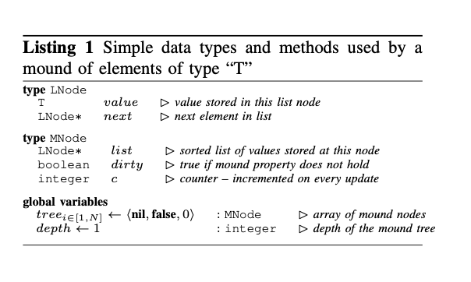
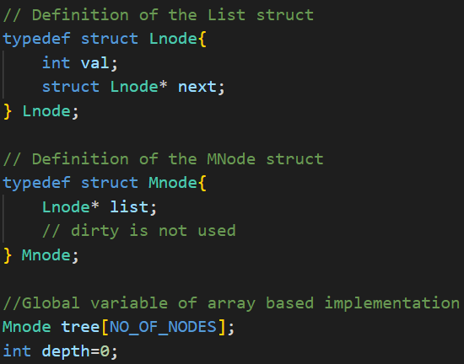
Listing 1 presents the basic data types for the mound.
We define a mound as an array-based binary tree of MNodes (tree) and a depth field. The MNode type describes nodes that comprise the mound’s tree. Each node consists of a pointer to a list.
The list holds values of type T, in sorted order. We define the value of a MNode based on whether its list is nil or not. If the MNode’s list is nil, then its value is ⊤. Otherwise, the MNode’s value is the value stored in the first element of the list, i.e., list.value. The val() function in is shorthand for this computation.

Slide 5
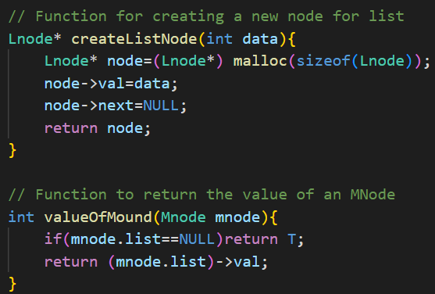
createListNode() function creates a new Lnode structure and initializes it with the given data value.
valueOfMound() function returns the value of an Mnode structure. If the list pointer of the Mnode structure is NULL, T is returned.

Slide 6
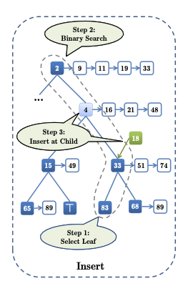
The Insert Operation
When inserting a value v into the mound, the only requirement is that there exist some node index c such that val(treec) ≥ v and if c!=1(c is not the root index), then for the parent index p of c, val(treep) ≤ v. When such a node is identified, v can be inserted as the new head of treec.list.
Inserting v as the head of treec.list clearly cannot violate the mound property: decreasing val(treec) to v does not violate the mound property between treep and treec, since v ≥ val(treep). Furthermore, for every child index c′ of c, it already holds that val(treec′ ) ≥ val(treec). Since v ≤ val(treec), setting val(treec) to v does not violate the mound property between treec and its children.

Slide 7
The insert(v) method operates as follows: it selects a random leaf index l and compares v to val(treel). If v ≤ val(treel), then either the parent of treel has a val() less than v, in which case the insertion can occur at treel, or else there must exist some node index c in the set of ancestor indices {⌊l/2⌋, ⌊l/4⌋, . . . , 1}, such that inserting v at treec preserves the mound property. A binary search is employed to find this index. Note that the binary search is along an ancestor chain of logarithmic length, and thus the search introduces O(log(log(N)) overhead.
The leaf is ignored if val(treel) < v, since the mound property guarantees that every ancestor of treel must have a val() < v, and another leaf is randomly selected. If too many unsuitable leaves are selected (indicated by a tunable THRESHOLD parameter), the mound is expanded by one level.

Slide 8
Implementation of INSERT Operation

Slide 9
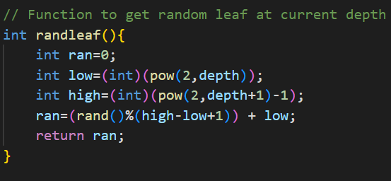
randleaf() function returns a random leaf node at the current depth of the Mound.

Slide 10
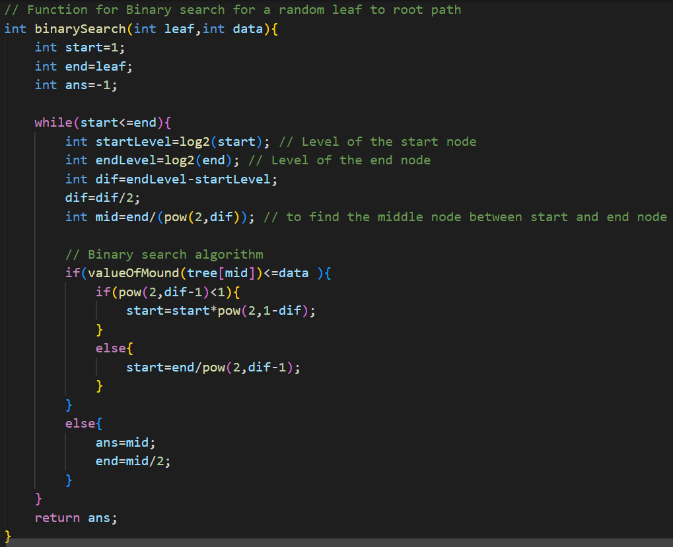
binarySearch() function performs binary search on the Mound data structure to find the insertion point for a new value. It takes two parameters, leaf, which is the index of the leaf node to start the search from, and data, which is the value to be inserted. The function returns the index of the parent node of the insertion point.

Slide 11
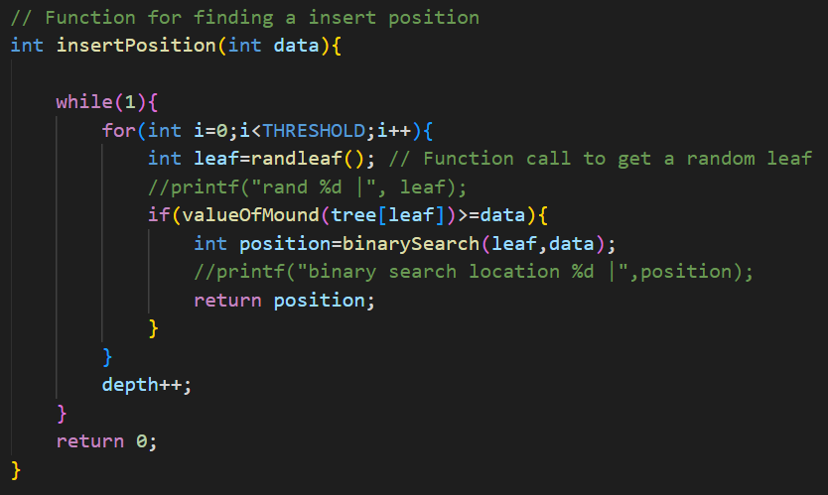
insertPosition() function returns the insertion point for a new value. It uses binarySearch() and randleaf() functions to find the insertion point. The function also updates the global variables depth as needed.

Slide 12
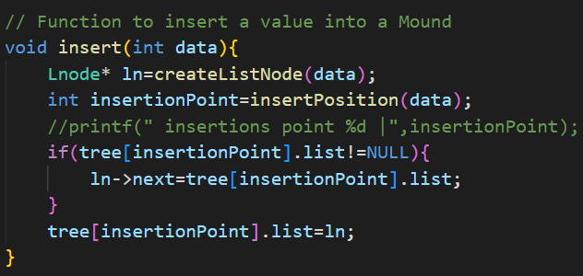
insert() function inserts a new value into the Mound data structure. It creates a new Lnode structure with the given data value, finds the insertion point using the insertPosition() function, and inserts the Lnode structure at the beginning of the linked list pointed to by the list pointer of the Mnode structure at the insertion point.

Slide 13
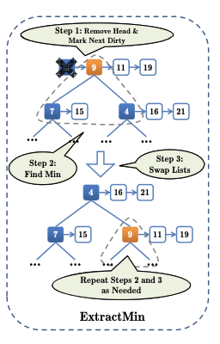
The ExtractMin Operations
ExtractMin resembles its analog in traditional heaps. When the minimum value is extracted from the root, the root’s val() changes to equal the next value in its list, or ⊤ if the list becomes empty.
At this point, the mound property may not be preserved between the root and its children, so we resolve this using Moundify function, where it recursively finds the minimum value out of the parent and its two children swaps the minimum value list at its correct position until the mound property is established.

Slide 14
To restore the mound property at N , a helper function (moundify) is used. It analyzes the triangle consisting of a dirty node and its two children. If either child is dirty, it first calls moundify on the child, then restarts. When neither child is dirty, moundify inspects the val()s of tree and its children, and determines which is smallest.
If treen has the smallest value, or if it is a leaf with no children, then the mound property already holds, and the treen.dirty field is set to false. Otherwise, swapping treen with the child having the smallest val() is guaranteed to restore the mound property at treen, since val(treen) becomes ≤ the val() of either of its children. However, the child involved in the swap now may not satisfy the mound property with its children, and thus its dirty field is set true. In this case, moundify is called recursively on the child. Just as in a traditional heap, O(log(N)) calls suffice to “push” the violation downward until the mound property is restored.

Slide 15
Implementation of ExtractMin Operation

Slide 16
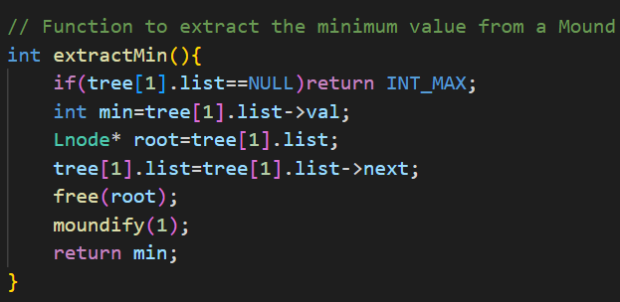
extractMin() function extracts the minimum value from the Mound data structure. It returns INT_MAX if the Mound is empty. It extracts the minimum value from the root node of the Mound, updates the list pointer to point to the next node in the linked list of root node, and then restores the Mound property using the moundify() function for the newly made root node.

Slide 17
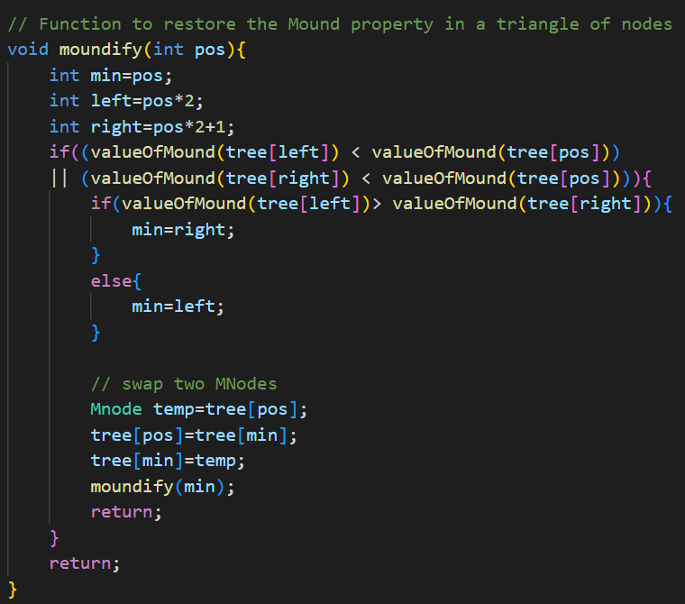
moundify() function restores the Mound property in a triangle of nodes. It takes an integer pos as input, which is the index of the parent node of the triangle. The function compares the values of the parent node and its two child nodes, and swaps the parent node with the child node with the minimum value if necessary. The function then recursively calls itself on the child node that was swapped with the parent node.

Slide 18
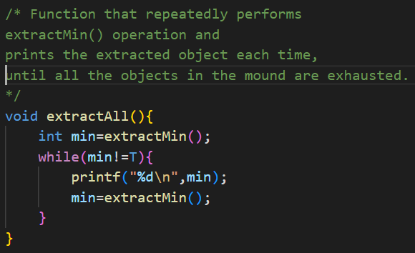
extractAll() function repeatedly calls extractMin() function to extract all the values from the Mound data structure, and prints each extracted value to the console.

Slide 19
THANKS!

